Slide 1

Crime Analysis In India Using R programming & SQL
BY Shumail ahsan

Slide 2
Project Overview
Objectives :-
Analyze total and category-wise crime trends across states and years.
Identify the most and least crime-affected states/districts.
Explore year-over-year crime growth trends.
Examine the relationship between literacy rates and total crime.
Perform comprehensive data cleaning and quality checks for accurate insights.

Slide 3
Tools & Technologies
R Programming :- Data cleaning, transformation, visualization.
PostgreSQL :- SQL queries for aggregation, filtering, and data insights.
Ggplot2 :- Custom visualizations and trend analysis.
dplyr & tidyverse :- Data wrangling and reshaping.

Slide 4

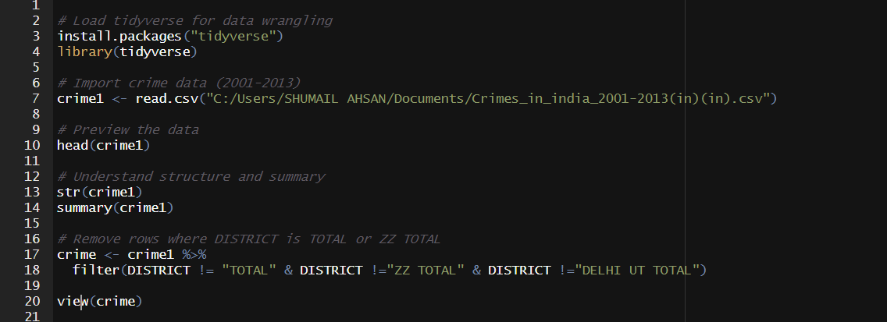
Programming
Data Import & Cleaning: Preparing Crime Dataset for Analysis

Slide 5
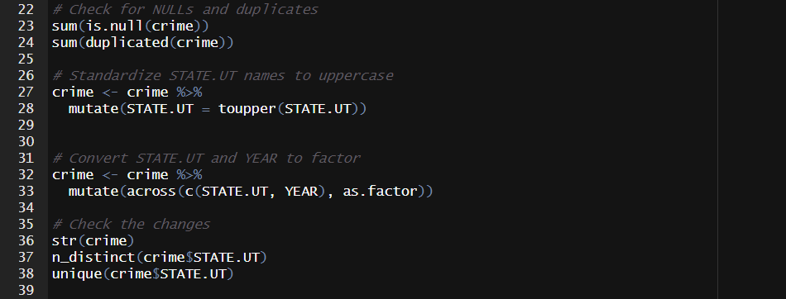
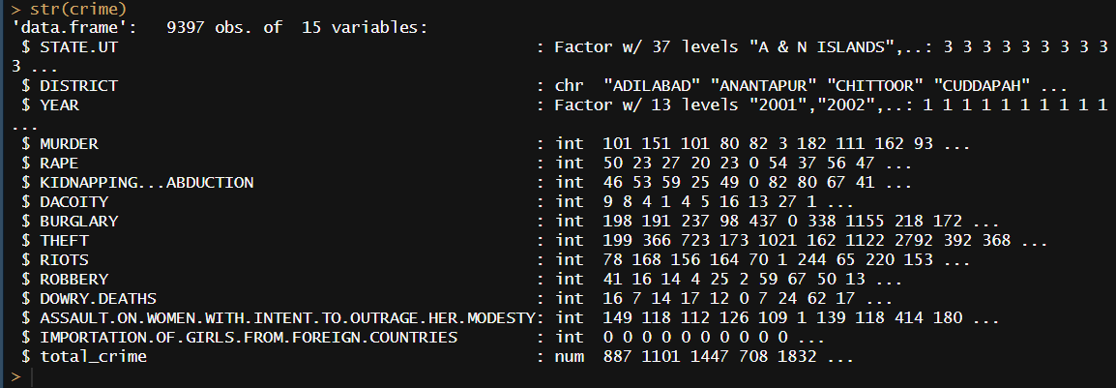
Data Standardization & Quality Checks Standardization & Quality Checks

Slide 6
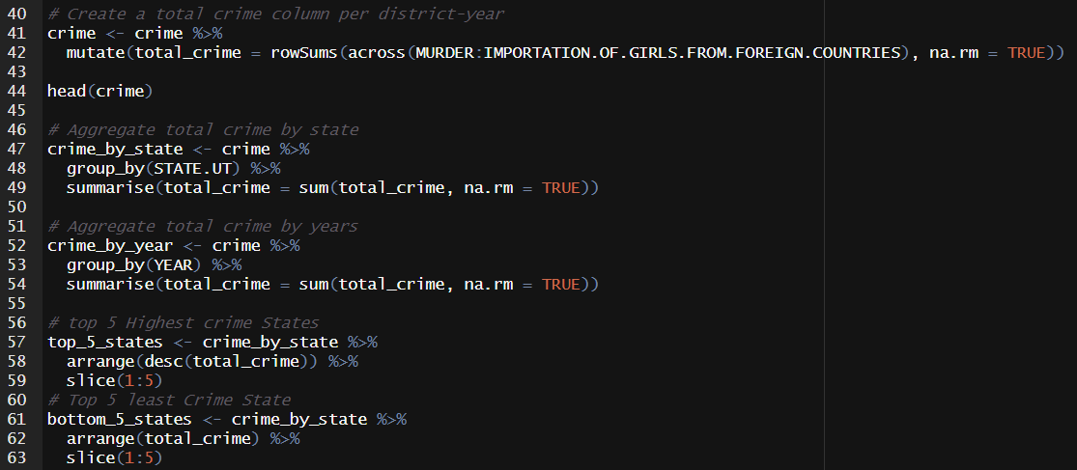
Calculated Total Crime per district-year across major categories.
Aggregated by State & Year to identify trends and top/low crime regions.

Slide 7
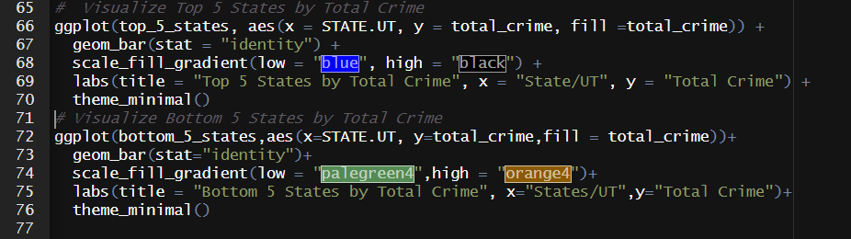
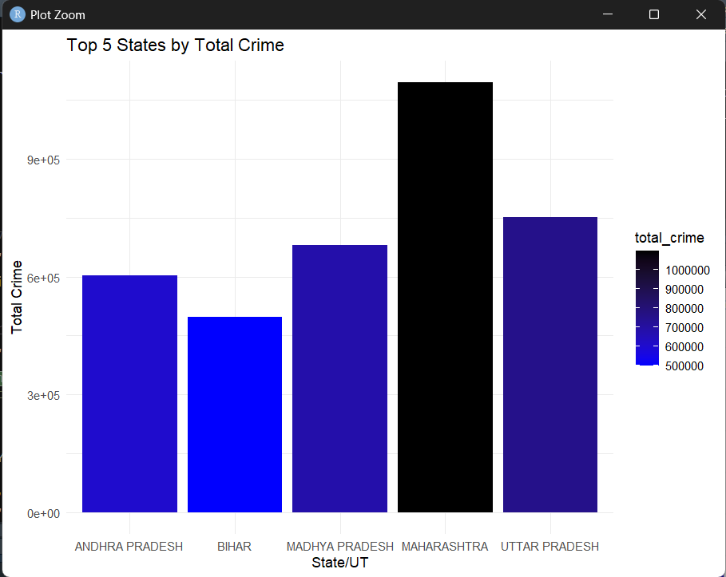
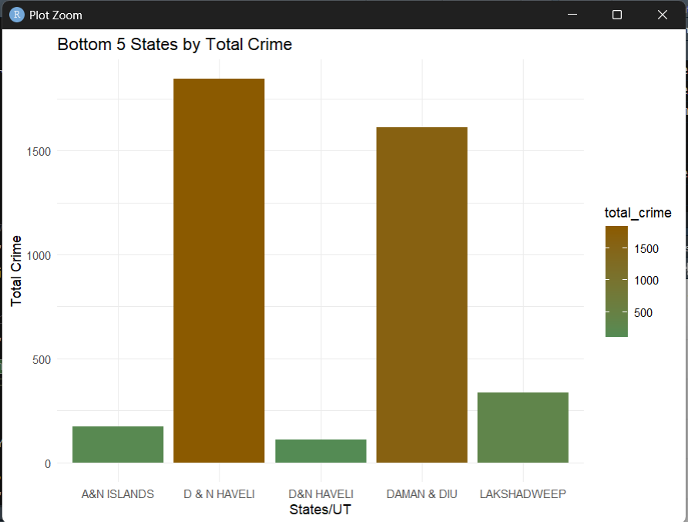
Bar plots highlight top 5 and bottom 5 states by total reported crimes.

Slide 8
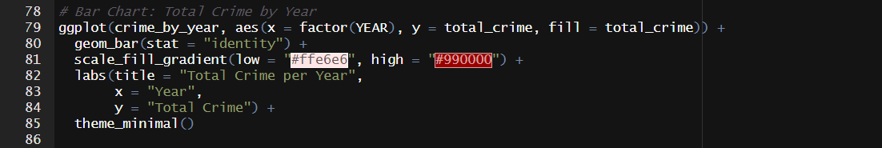
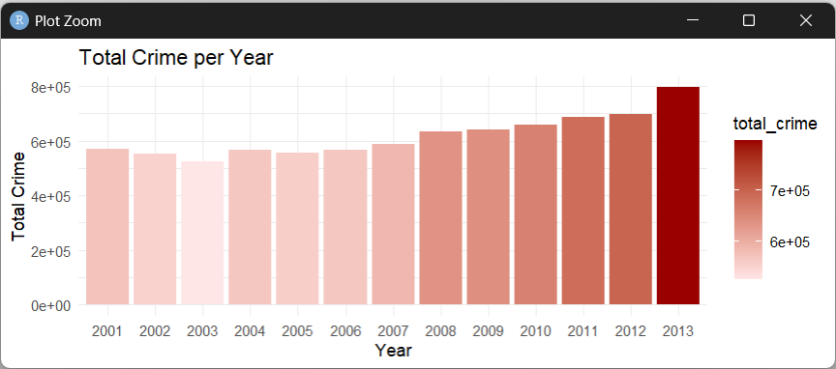
Total Crime By Year

Slide 9
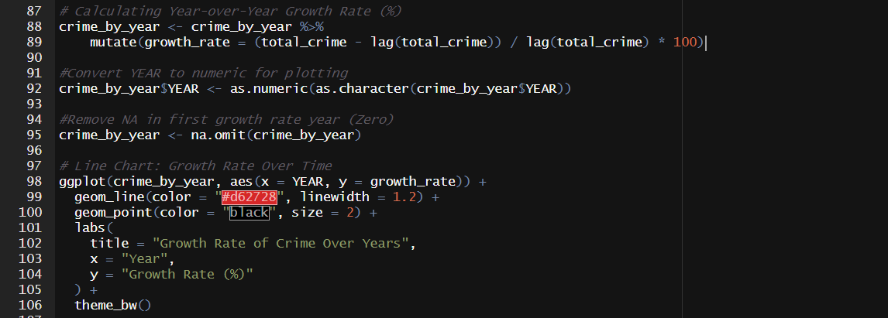
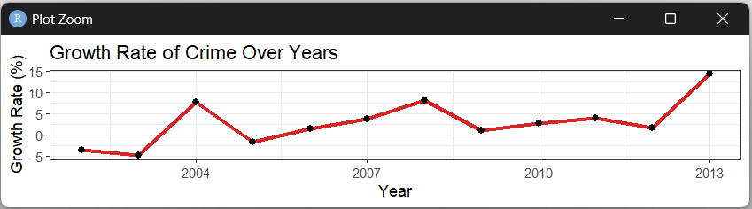
Yearly Crime Growth Rate Trend (2002–2013)

Slide 10
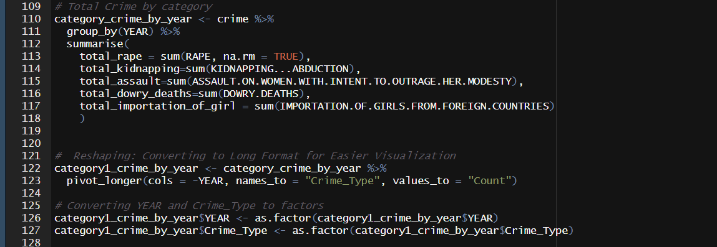
Total Crime by Crime Category (2001–2013): Year-wise Breakdown and Reshaping

Slide 11
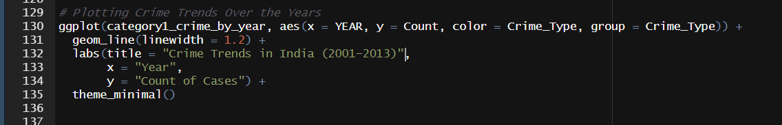
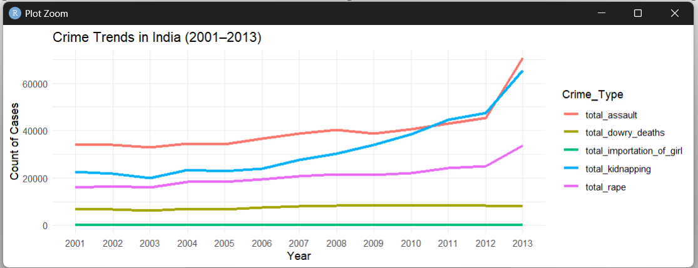
Crime Trends in India (2001–2013): Year-wise Analysis by Crime Category

Slide 12
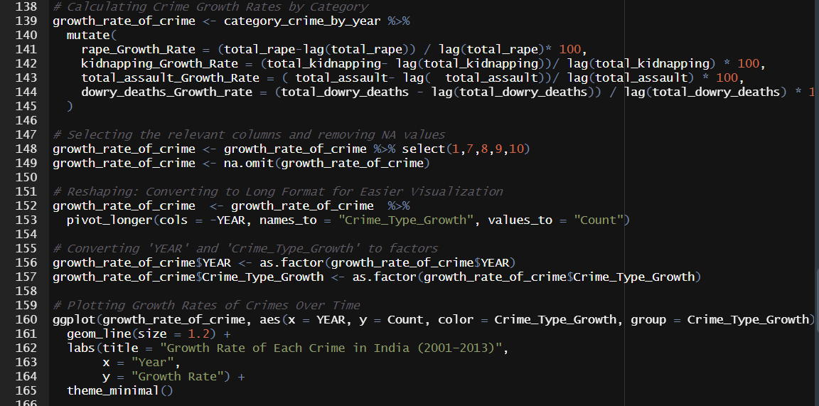
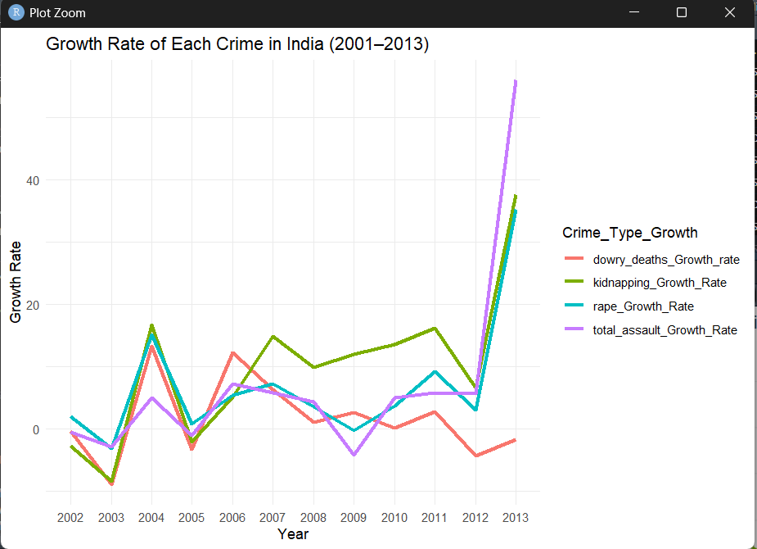
Trends in Crime Growth: A Yearly Breakdown (2001–2013)

Slide 13
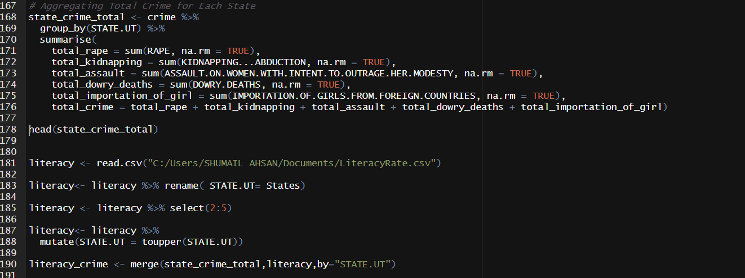
Literacy and State-wise Crime Data Integration (2001–2013)

Slide 14
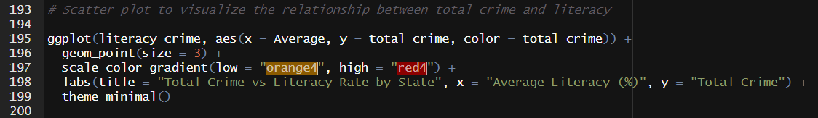
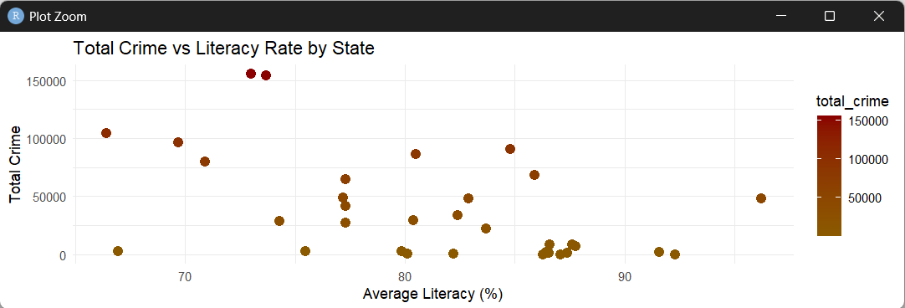
Exploring the Link Between Crime Rates and Literacy Across States"

Slide 15

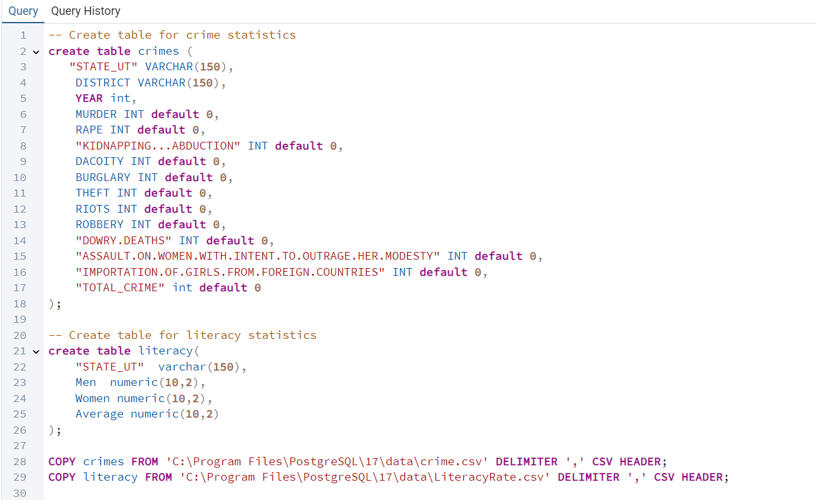
PostgreSQL
Creating and Importing Crime & Literacy Data into PostgreSQL

Slide 16
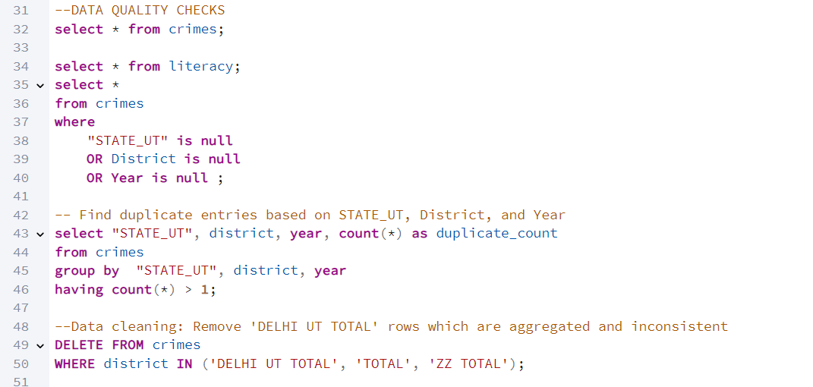
Comprehensive Data Quality Checks: Handling Nulls, Duplicates, and Removing Inconsistent Entries

Slide 17
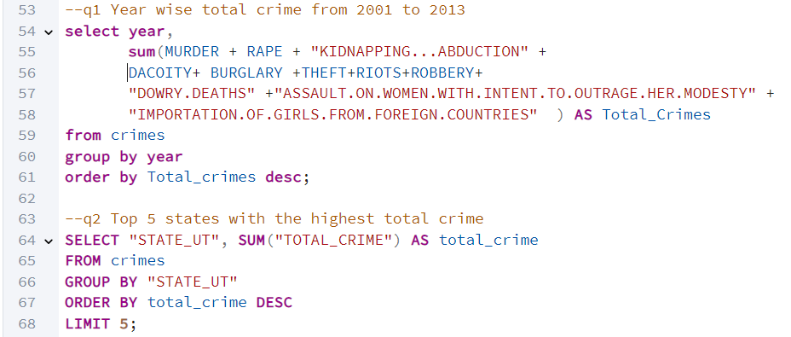
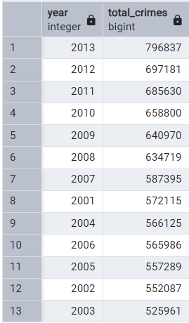
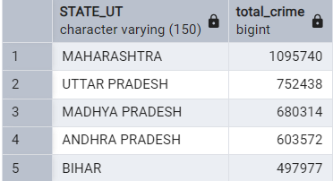
Q1: What is the year-wise total number of crimes reported from 2001 to 2013?
Q2: Which five states have the highest total reported crimes during the period?

Slide 18
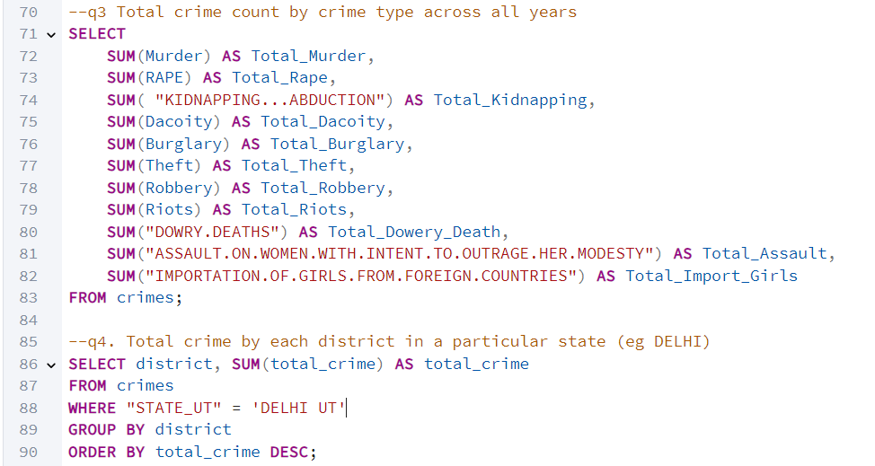
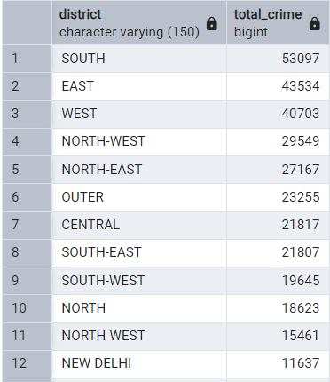
Q3: What is the total number of crimes by type across all years
Q4: What is the total crime count for each district in a selected state (e.g., Delhi)?

Slide 19
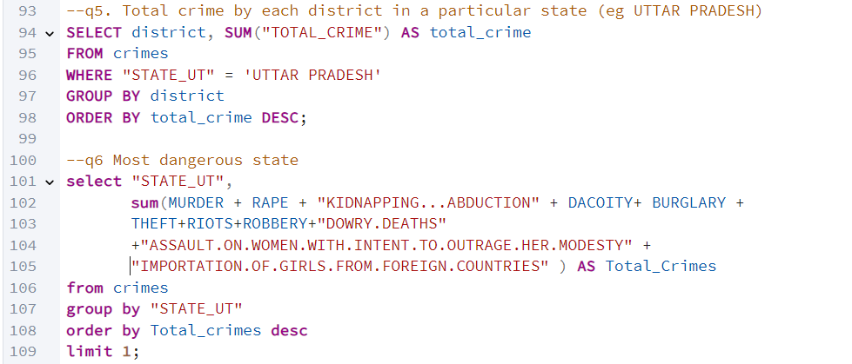
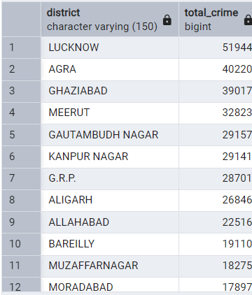

Q5: What is the total crime count by district in Uttar Pradesh ?
Q6: Which state reported the highest total crime and can be considered the most dangerous?

Slide 20
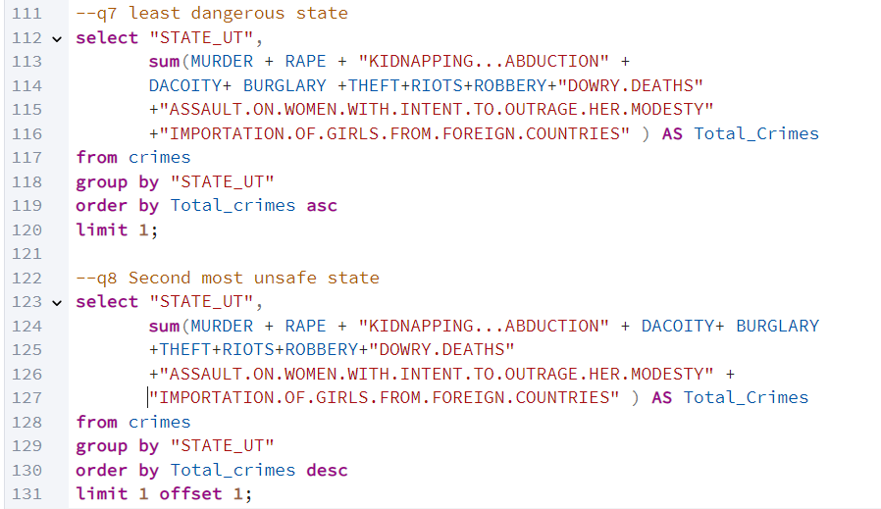


Q7: Which state has the lowest total crime and is considered the least dangerous?
Q8: Which state ranks second in terms of highest total crime?

Slide 21
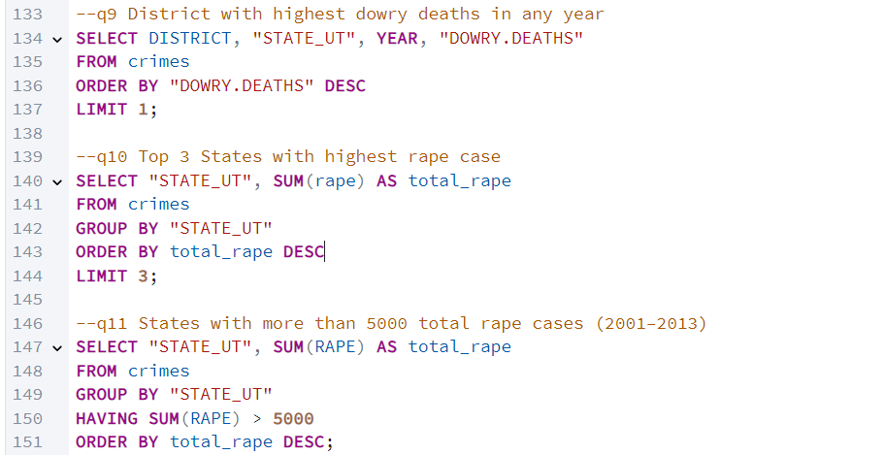

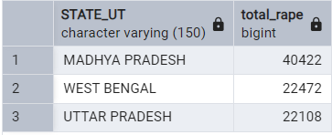
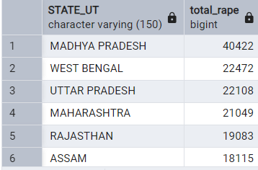
Q9: Which district recorded the highest number of dowry deaths in a single year?
Q10: What are the top 3 states with the highest number of rape cases (2001–2013)?
Q11: Which states reported more than 5,000 rape cases between 2001 and 2013?

Slide 22
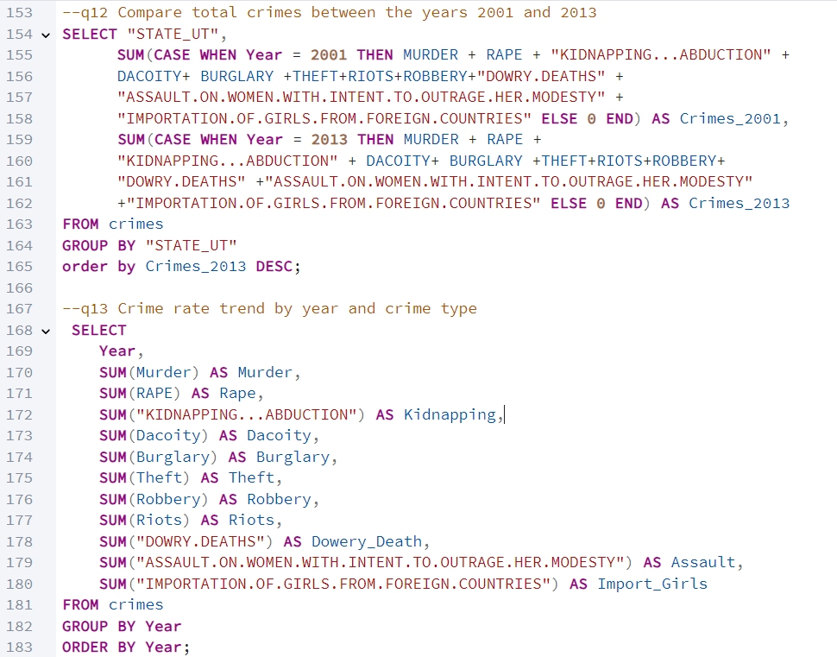
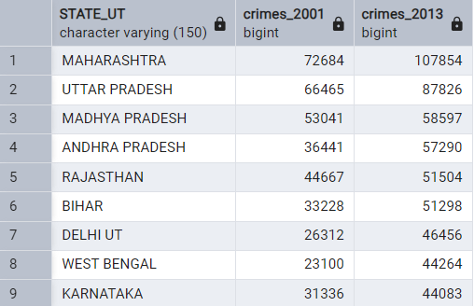
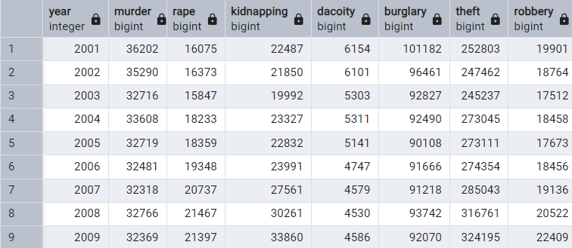
Q12: How does total crime in each state compare between the years 2001 and 2013?
Q13: What is the year-wise trend of various crime types across India (2001–2013)?

Slide 23
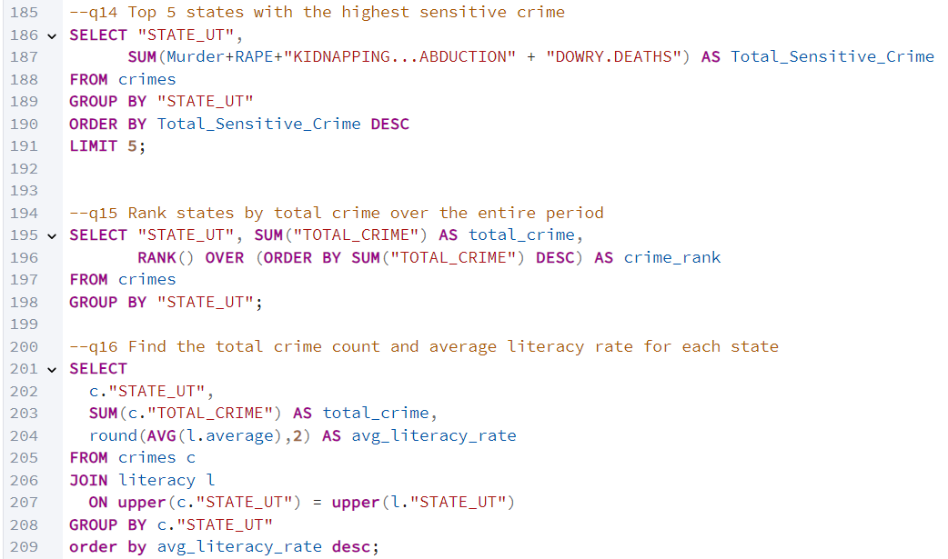
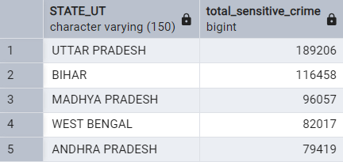
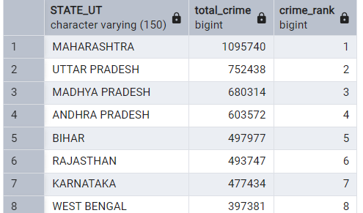
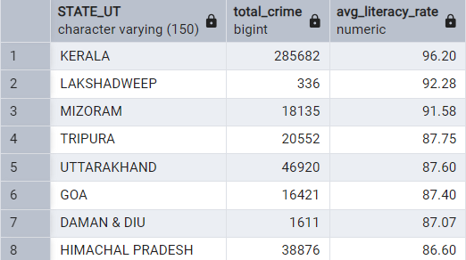
Q14: Which 5 states recorded the highest number of sensitive crimes?
Q15: How do Indian states rank based on total crime reported from 2001 to 2013?
Q16: What is the relationship between total crime and average literacy rate in each state?

Slide 24
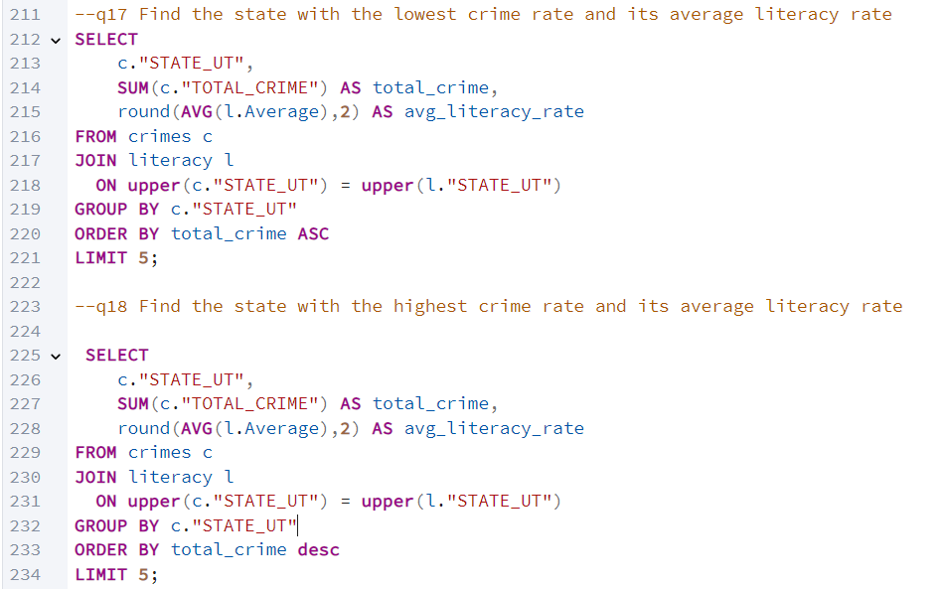
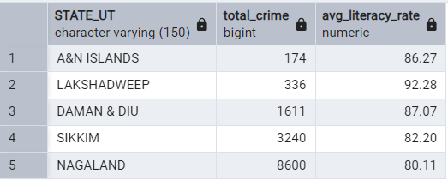
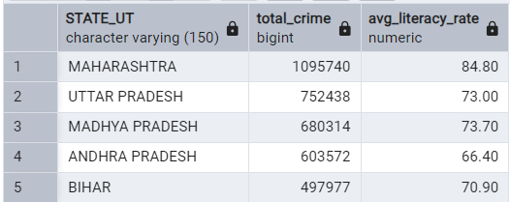
Q17: Which state has the lowest crime rate and what is its average literacy rate?
Q18: Which state has the highest crime rate and what is its average literacy rate?

Slide 25
Key Insights
Crime Overview
Top Crime States: Maharashtra, Uttar Pradesh, Madhya Pradesh, Bihar, Andhra Pradesh.
Lowest Crime: Lakshadweep, Daman & Diu, Andaman & Nicobar Islands.
Crime Trends (2001–2013): Steady increase in kidnapping, rape, dowry deaths, and assaults.
Literacy & Crime
States with lower literacy often show higher crime rates (notably in UP, Bihar).
High literacy regions show comparatively lower crimes, indicating possible inverse relationship.
Crime Type Growth Rate (2001–2013)
Rape: ↑ ~80% growth.
Kidnapping & Abduction: ↑ ~130% (highest growth).
Dowry Deaths: ↑ ~30%.
Assault on Women: ↑ ~95%.
Murder: Relatively stable, slight rise.
Top Region in Sensitive Crimes (2001–2013)
--Uttar Pradesh
Highest total in Murder, Dowry Deaths, and Kidnapping

Slide 26
Conclusion & Learnings
Strengthened expertise in SQL querying, including complex JOINs, nested subqueries, Common Table Expressions (CTEs), window functions (RANK()), and advanced aggregation(GROUP BY) techniques for structured data extraction.
Applied R programming extensively, leveraging the tidyverse ecosystem (dplyr, tidyr, ggplot2) for data wrangling, cleaning, transformation (including unpivoting via pivot_longer), and exploratory data analysis (EDA).
Improved ability to derive actionable insights from raw, messy, and semi-structured datasets through a combination of SQL and R-based workflows.
Enhanced the efficiency and reliability of data pipelines, supporting faster and more accurate data-driven decision-making.

Slide 27

Thank you !

